Slide 1















Title: Enhanced WhatsApp Chat Analysis using NLP and Transformer Models
OUR TEAM
Claudia Alves
BATHALA LOKESH
Daddanala kaleswara manikanta
kannikanti kranthi kumari

Slide 2

Abstract
This project focuses on analyzing WhatsApp chat data using NLP techniques and transformer models. The main goal here was to identify the distribution of sentiment and pattern of conversation inside group conversations using pre-trained models like BERT, DistilBERT, RoBERTa, and ALBERT. This involved data pre-processing, sentiment labelling, and visualising of chat dynamics. Several models were trained and tested with accuracy, precision, recall, and F1 score as evaluation metrics. The best results were achieved by RoBERTA. It was concluded that transformer-based models are effective in analyzing informal text data and could provide insights into trends in communication and user behavior.

Slide 3
Project Overview , Goal and Significance
This project analyzes WhatsApp chat data using NLP techniques and transformer models to understand chat dynamics and sentiment distribution.
01.
To utilize pre-trained models like BERT, DistilBERT, RoBERTa, and ALBERT to classify WhatsApp messages and compare their performance.
02.
This project analyzes WhatsApp chat data using NLP techniques and transformer models to understand chat dynamics and sentiment distribution.
Understanding chat patterns can provide insights into user behavior, sentiment trends, and overall group communication dynamics, which can be valuable for social analysis and improving communication tools.
03.

Slide 4
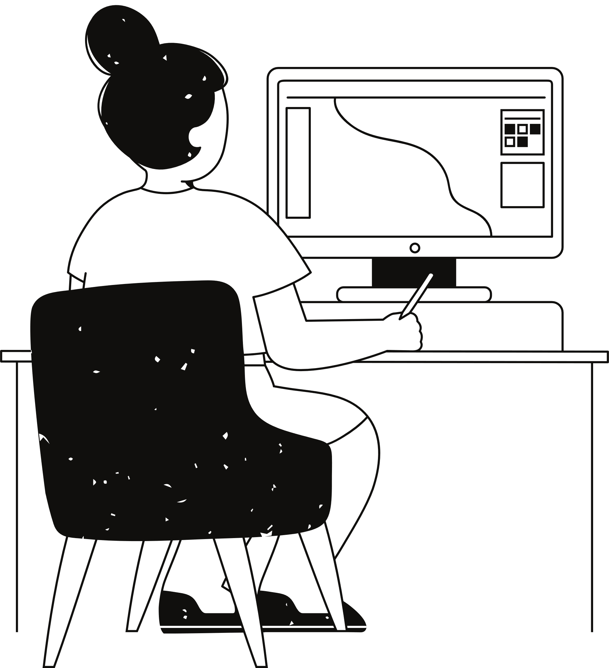
Dataset Overview
Dataset: WhatsApp group chat data and Normal data.
Key features:
Messages with date, time, and sender details.
System messages and multimedia information included.

Slide 5
Data Preprocessing
01
02
03
04
Loading chat data and parsing with regex.
Removing system messages and empty lines.
Converting date and time into proper datetime format.
Tools used: pandas, regex library, etc.

Slide 6
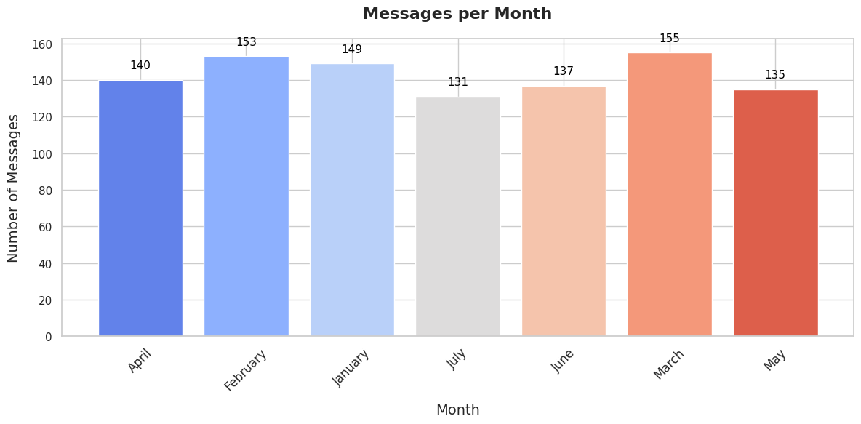
Exploratory Data Analysis (EDA)
Messages by day of the week, hour of the day, and month.
Top active users and "ghost" users.

Slide 7
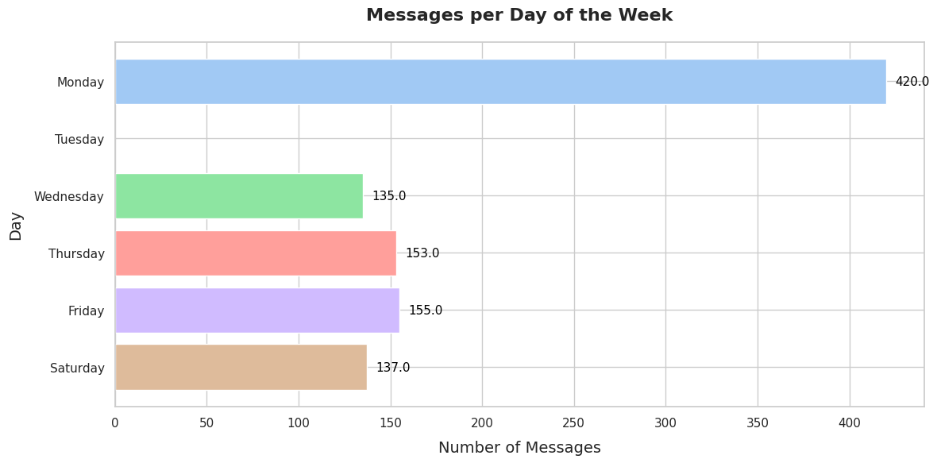

Slide 8
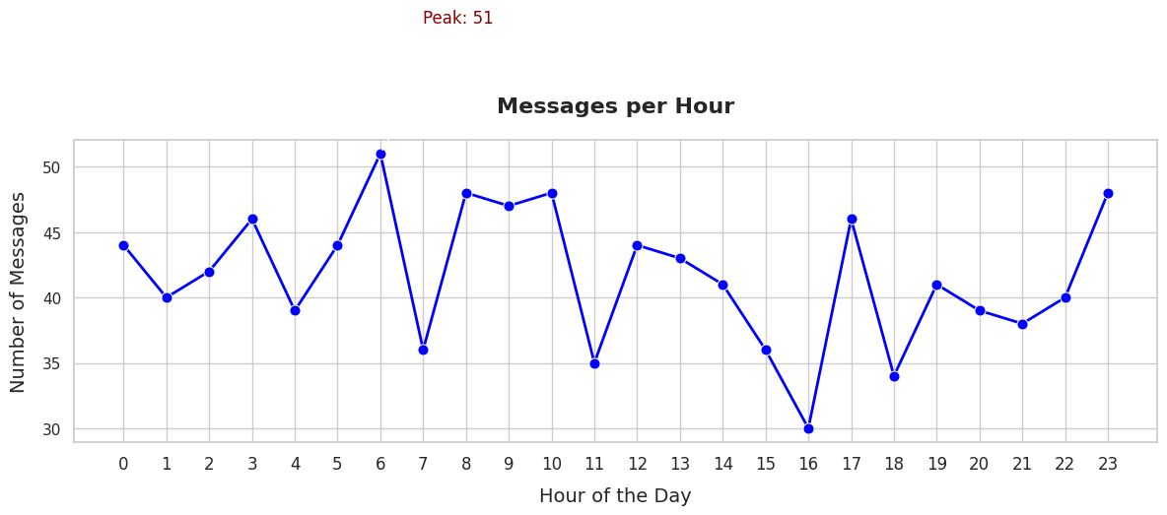

Slide 9





Sentiment Labeling:
Labeled messages as Positive, Negative, or Neutral using keyword matching and emojis.
Tools Used: LabelEncoder, train_test_split.
Sentiment Labeling and Data Split
Train-Test Split:
Models Used:
BERT, DistilBERT, RoBERTa, and ALBERT.
Splitting data into 80% training and 20% testing.

Slide 10

Transformer Models and Approach
Implementation:
Models Compared:
BERT, DistilBERT, RoBERTa, and ALBERT.
:
Tokenized messages and trained sequence classification models.
Training Details:
Number of epochs=3
batch sizes=16

Slide 11

Training and Evaluation Metrics
Metrics: Accuracy, Precision, Recall, F1 Score.
Evaluation Results:
RoBERTa achieved the highest F1 score.

Slide 12
Model: bert-base-uncased
Accuracy: 0.8909 F1
Score: 0.8706
Precision: 0.8691
Recall: 0.8909
Model: distilbert-base-uncased
Accuracy: 0.8909
F1 Score: 0.8706
Precision: 0.8691
Recall: 0.8909
Model: roberta-base
Accuracy: 0.9273
F1 Score: 0.9132
Precision: 0.9071
Recall: 0.9273
Model: albert-base-v2
Accuracy: 0.8909
F1 Score: 0.8706
Precision: 0.8691
Recall: 0.8909

Slide 13
91%
F1 Score
Best model based on F1 score: roberta-base

Slide 14
Code Demo
Here is the Demo link of the code : Youtube LINK

Slide 15
Thank you very much!

